Slide 1
A PCCM BOOST PFC CONVERTER

Slide 2
Overview
Introduction
PCCM Boost PFC
Circuit operation
Waveform
Block diagram
Simulation Result
Conclusion
References

Slide 3
Introduction:
Conventional ac/dc power converters - connected to the line through full-wave rectifiers draw a non sinusoidal input current.
Harmonic content in a current - flowing through the impedances in the electric utility distribution system can create harmonic voltages.
Leads to distorted input current - prohibits the extraction of the maximum possible real power from the utility service.

Slide 4
Power-Factor Correction (PFC) converters employ
active wave shaping of the input current to ensure a sinusoidal current shape, while delivering a dc output voltage.
The primary tasks of a controller for a PFC converter are to:
achieve high power factor during steady-state operation.
maintain an output voltage waveform around a specified average value with low ripple.
respond quickly to load disturbances.

Slide 5
Active PFCs include:
Buck, Boost, Buck-boost converters etc.
In this PFC correction - tried to implement a PCCM Boost converter.
Why PCCM Boost?

Slide 6
Pccm boost pfc converter:
Derived from conventional boost PFC converter,
Fig 1: Circuit diagram of PCCM Boost Converter

Slide 7
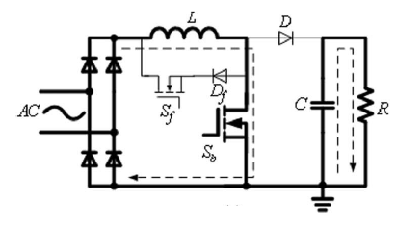
Circuit operation:
Has 3 operation modes in each switching cycle.
Mode I:Boost operation
Fig 2: Equivalent Circuit in d_{b}T

Slide 8
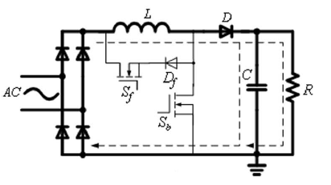
Mode II: Capacitor Charging operation
Fig 3: Equivalent Circuit in d_{c}T

Slide 9
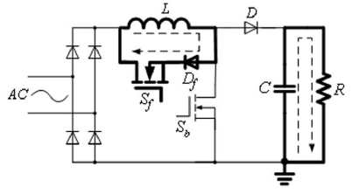
Mode III: Freewheeling operation
Fig 4: Equivalent Circuit in d_{f}T

Slide 10
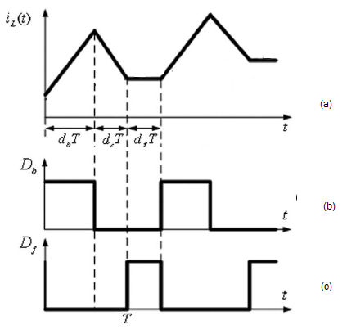
Waveforms
Fig 5: (a) Inductor current i_{L},
(b) drive pulse of boost switch S_{b}
(c) drive pulse of freewheeling switch S_{f}

Slide 11
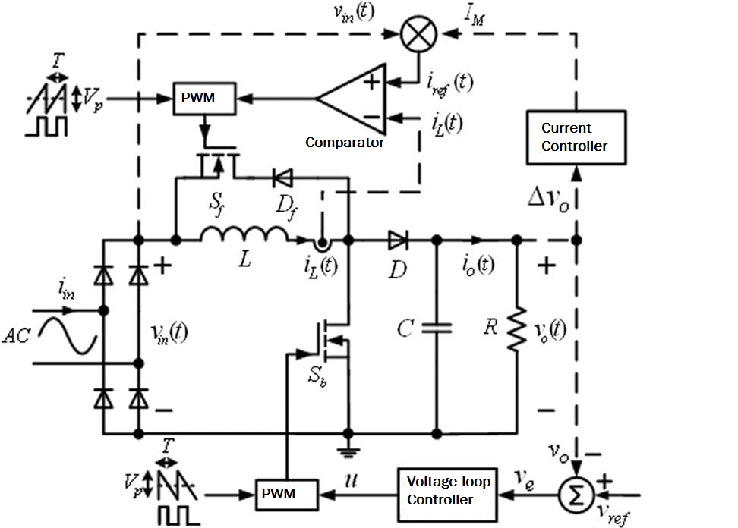
Block diagram:
Fig 6: Block diagram of the PCCM Converter with
closed loop control

Slide 12
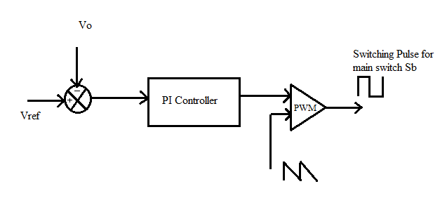
(A)Voltage loop control
Fig 7: Block diagram of voltage loop

Slide 13
(B)Current control loop
Fig 8: Block diagram of current control loop

Slide 14
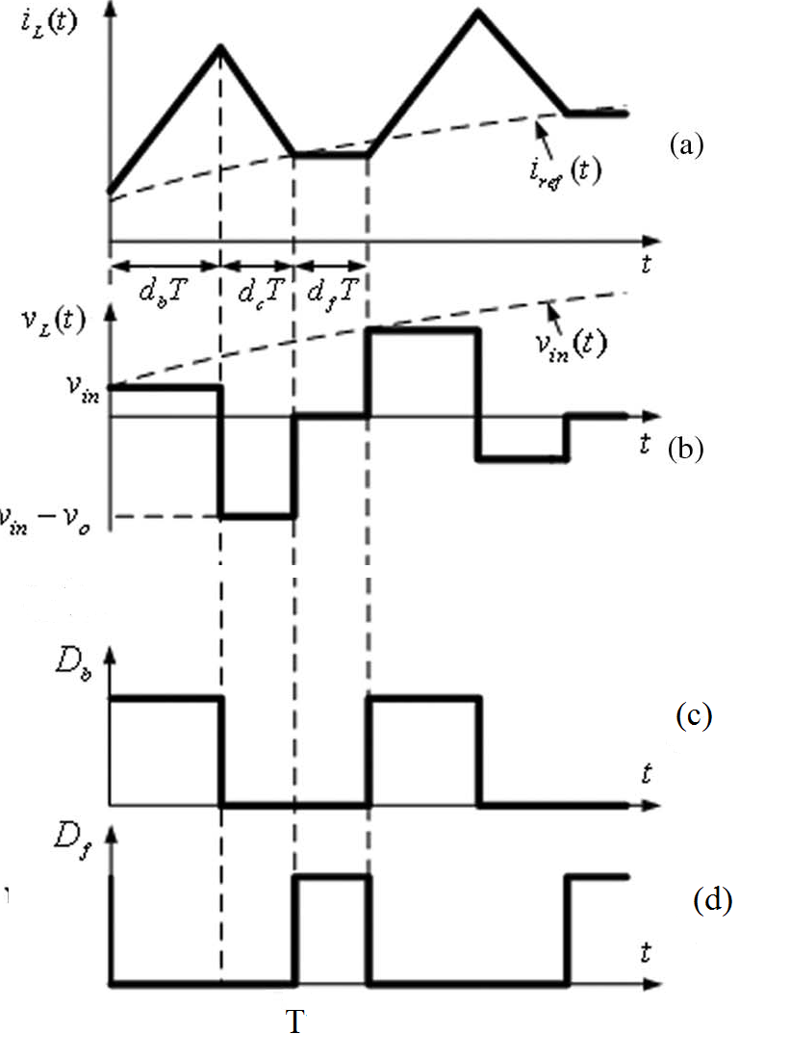
The ripple voltage is estimated by,
The magnitude of the desired inductor current which is taken as the reference current is obtained by,
Fig.9 : Waveforms of PCCM boost PFC converter. (a) Inductor current i_{L}(t), (b) Inductor voltage v_{L}(t), (c) drive pulse of boost switch S_{b}, and (d) drive pulse of freewheeling switch S_{f} .

Slide 15
DESIGN
Designed w.r.t to the following requirements:
Input Supply, V_{in} : 110Vrms voltage ac, 50Hz frequency
Output power, P_{o} : 200W
Output voltage, V_{o} : 200V
Load(Resistance), R : 100Ω
Switching frequency of the
main switch S_{b} and
freewheeling switch S_{f} , f_{s} : 50KHz

Slide 16
For a boost converter at the boundary condition, maximum output current is given by,
=2A.
Assuming for a duty ratio of 0.5,
Equating the above equations, we get,
=0.125mH, for DCM
L>>>0.125mH, take 2mH

Slide 17
Assumed peak ripple voltage of ±8V, value of filter capacitor is,
=400µF ≈ 470µF.

Slide 18
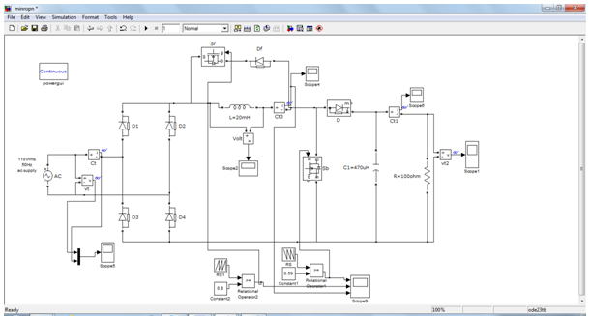
SIMULATION RESULTS
OPEN LOOP PCCM BOOST PFC
Fig 10: Simulated circuit diagram of open loop PCCM boost converter

Slide 19
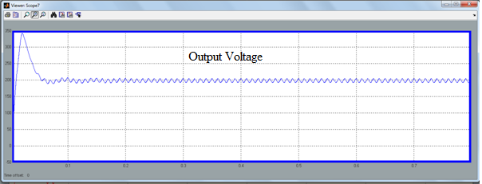
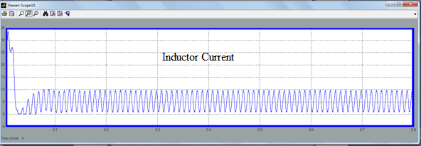
(a)
(b)
Fig 11:Waveforms of (a) Output voltage at 200V, (b) Inductor current

Slide 20
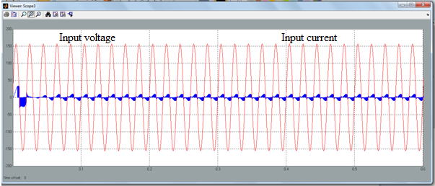
Fig 12:Waveform of Input voltage and input current of
open loop PCCM boost PFC converter with a pf of 0.87

Slide 21
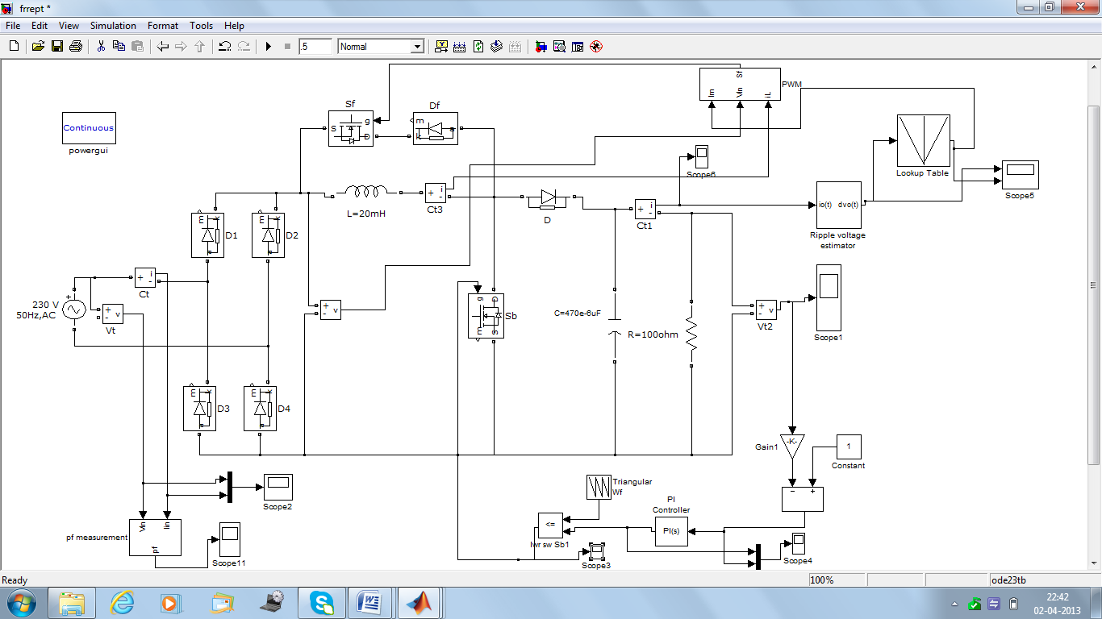
CLOSED LOOP CONTROL PCCM BOOST PFC
Fig 13: Simulated circuit diagram of PCCM boost PFC converter with closed loop control

Slide 22
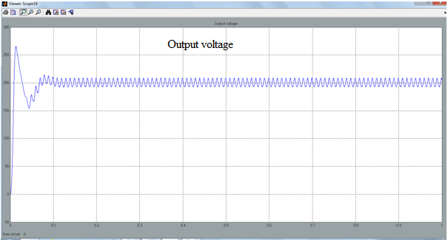
Fig 14: Waveform of Output voltage

Slide 23
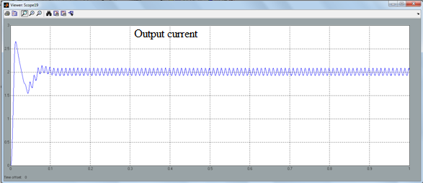
Fig 15: Waveform of Output current

Slide 24
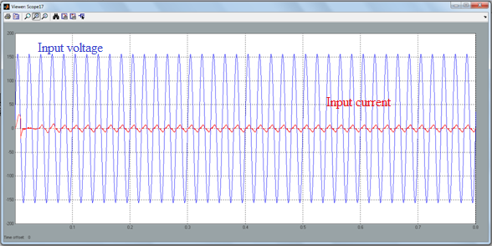
Fig 16: Waveform of input voltage and input current with an improved pf of 0.94

Slide 25
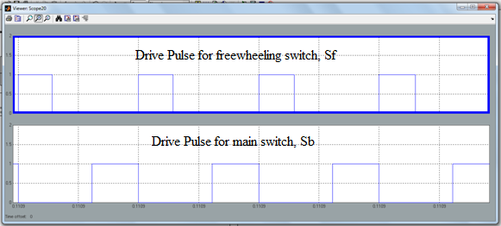
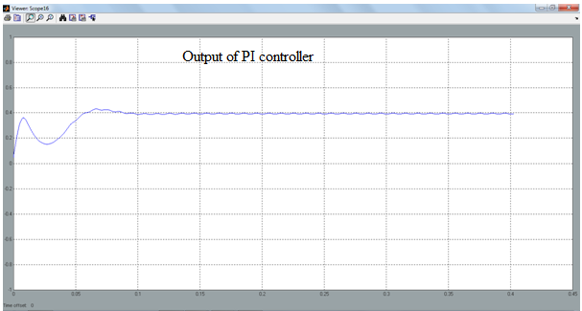
(a)
(b)
Fig 17: Waveforms of: (a) Drive pulses for switches S_{f} and S_{b},
(b) Output of PI Controller

Slide 26
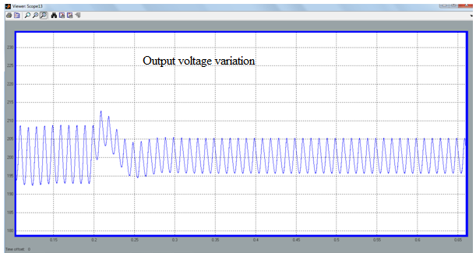
DYNAMIC RESPONSE OF THE CONVERTER
(a) Load Disturbance:
Under load variation-from 400W to 200W
Fig 18: Transient response of the converter under step load variation
of 400 to 200W: Output voltage

Slide 27
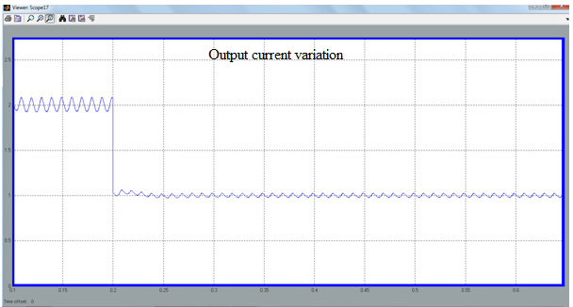
Fig 19: Transient response of the converter under step load variation
of 400 to 200W: Output current

Slide 28
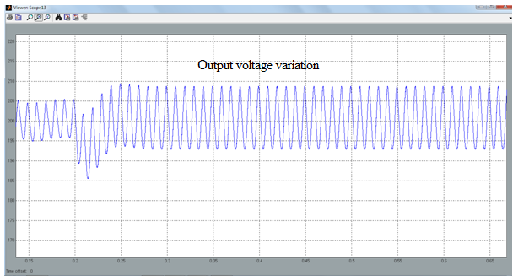
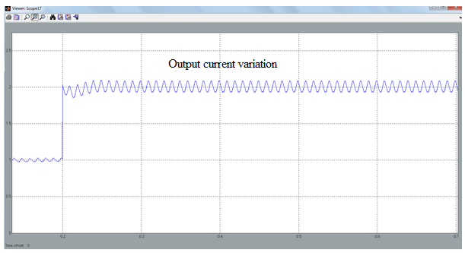
Under load variation-from 200W to 400W
(a)
(b)
Fig 20: Transient response of the converter under step load variation
of 200 to 400W:(a) Output voltage, (b) Output current

Slide 29
Table : Transient performance observation of the PCCM boost converter under load variations
 | Load power step change from 400W to 200W | Load power step change from 200W to 400W
Undershoot voltage | 0 | 14V
Overshoot voltage | 13V | 0
Settling time | 70ms | 70ms

Slide 30
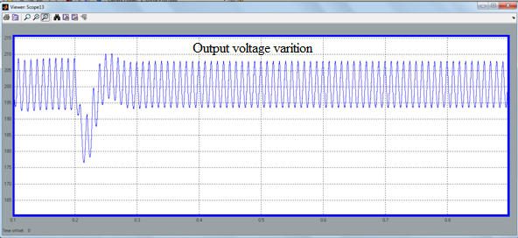
(b) Input voltage variation:
Under input voltage variation-from 110Vrms to 98Vrms
Fig 21: Transient response of the converter under step decrease in input voltage variation of 110Vrms to 98Vrms: Output voltage

Slide 31
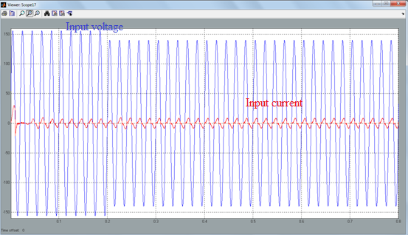
Fig 22: Transient response of the converter under step decrease in input voltage variation of 110Vrms to 98Vrms: Input voltage and input current with pf 0.94

Slide 32
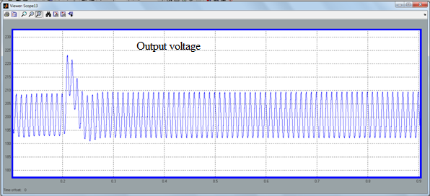
Under input voltage variation-from 110Vrms to 120Vrms
Fig 23: Transient response of the converter under step increase in input voltage variation
of 110Vrms to 120Vrms: (a) Output voltage

Slide 33
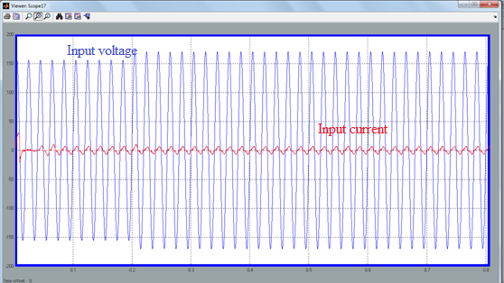
Fig 24: Transient response of the converter under step increase in input voltage variation of 110Vrms to 120Vrms: (a) Input voltage and input current with pf 0.94

Slide 34
Table : Transient performance observation of the PCCM boost converter under load variations
 | Input voltage step change from 110Vrms to 98Vrms | Input voltage step change from 110Vrms to 120Vrms
Undershoot voltage | 22V | 0
Overshoot voltage | 0 | 23
Settling time | 65ms | 65ms

Slide 35
CONCLUSION:
Simulated the open loop and closed loop controlled PCCM boost converter for an output power of 400W.
OPL – pf of 0.87
CL – pf of 0.94
In closed loop system, has 2 independent voltage and current loops.
Voltage loop controls the switching of main switch and regulates output voltage at 200V.
Current control loop controls the switching of freewheeling switch and improves the power factor.
Due to independent control loops, the system has fast dynamic response under disturbances.

Slide 36
references
Fei Zhang and Jianping Xu, “A Novel PCCM Boost PFC ConverterWith Fast Dynamic Response” IEEE Trans. on Ind. electroni, vol. 58, no. 9, september 2011
S. Wall and R. Jackson, “Fast controller design for single-phase power factor correction systems,” IEEE Trans. Ind. Electron., vol. 44, no. 5, pp. 654–660, Oct. 1997.
A. Prodic, D. Maksimovic, and R. W. Erickson, “Dead-zone digital controllers for improved dynamic response of low harmonic rectifiers,” IEEE Trans. Power Electron., vol. 21, no. 1, pp. 173–181, Jan. 2006.
D. Ma,W.-H. Ki, and C.-Y. Tsui, “A pseudo-CCM/DCM SIMO switching converter with freewheel switching,” IEEE J. Solid-State Circuits, vol. 38, no. 6, pp. 1007–1014, Jun. 2003.
Abraham I. Pressman, Keith Billings, Taylor Morey “Switching Power Supply Design”, Tata McGraw-Hill ,Third Edition 2009.
Ned Mohan, Tore M Undeland, William P Robbins “Power Electronics-Converters, Applications and Design” Wiley India Edition 2006.

Slide 37
Thank you…..

